Slide 1
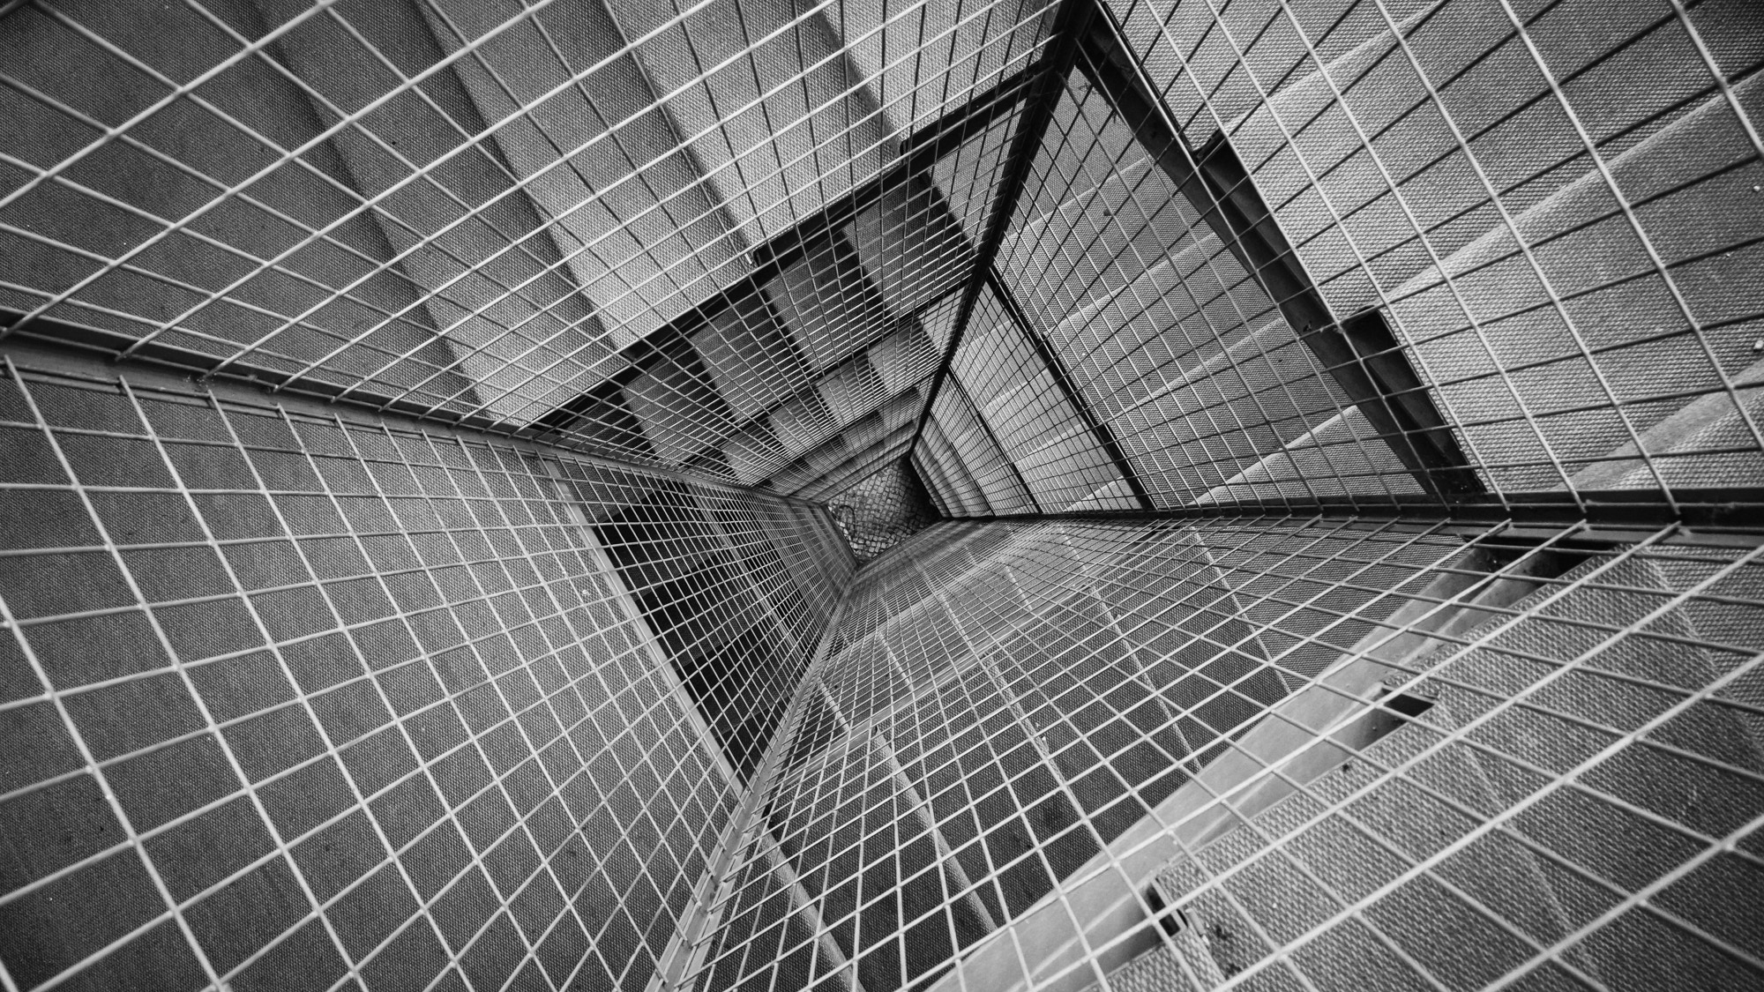
WHICH PART OF CALGARY PARTIES THE MOST
Ben LeBlanc

Slide 2
WHY? How?
I thought it would be fun to rank each of Calgary’s quadrants against each other, to see which quadrant parties the most, which is very important to us university students as well. What else do we do when we’re done exams?
Obviously that is a bit difficult to do so I did the next best thing, I took business license data and focused on stores/restaurants with alcohol and cannabis.
I want the Calgarians to see the city in a different light, and to see how many locations around the city you can go to get your party started.
Notes:
Did the presenter make it clear why this question is interesting, impactful, or would help a decision-maker or policy-maker make a good decision? Did the presenter define the target audience of the project? To what extent were the questions of interest well-motivated?

Slide 3
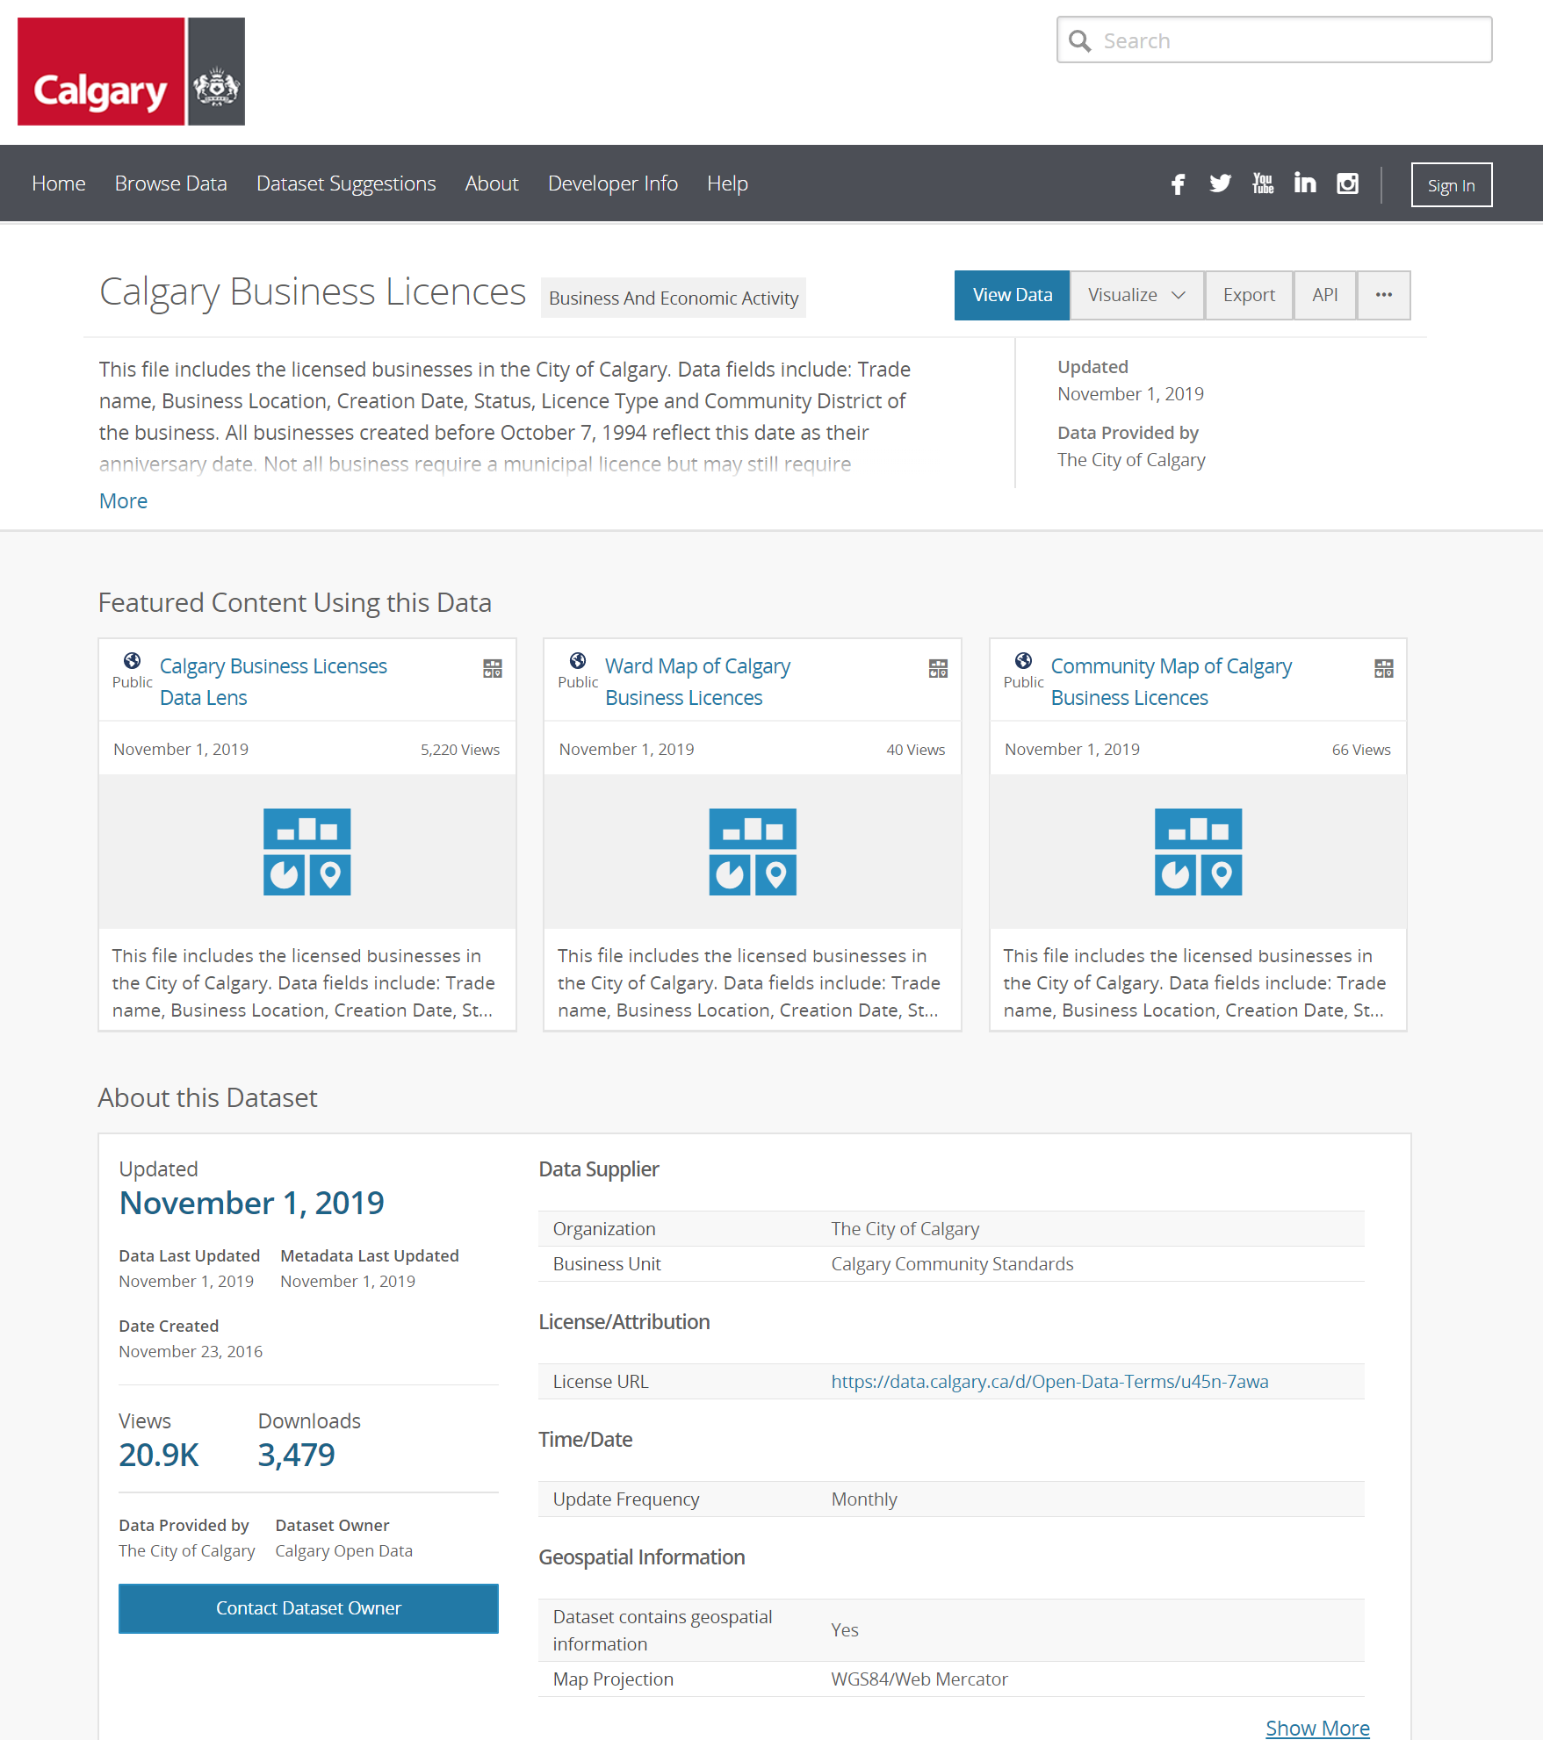
Data collection process
Scrapping the API from Open Calgary
Found the data on Open Calgary of Business License Data.
Used packages httr, lubridate, jsonlite, and most importantly dplyr to call from an API within R to get the data.
Filtered for only currently LICENSED businesses. No expired businesses.
After that, I filtered the license types looking only for alcohol and cannabis related licenses.
Then finally, I used stringr to search the address column, and then to add a new column called quadrant;
NW, NE, SE, SW
https://data.calgary.ca/Business-and-Economic-Activity/Calgary-Business-Licences/vdjc-pybd
Notes:
Did the presenter describe their data source(s) and/or their data collection process? Give a score of 0 if the presenter did not, or give 10 if the presenter did.

Slide 4

Visualization

Slide 5
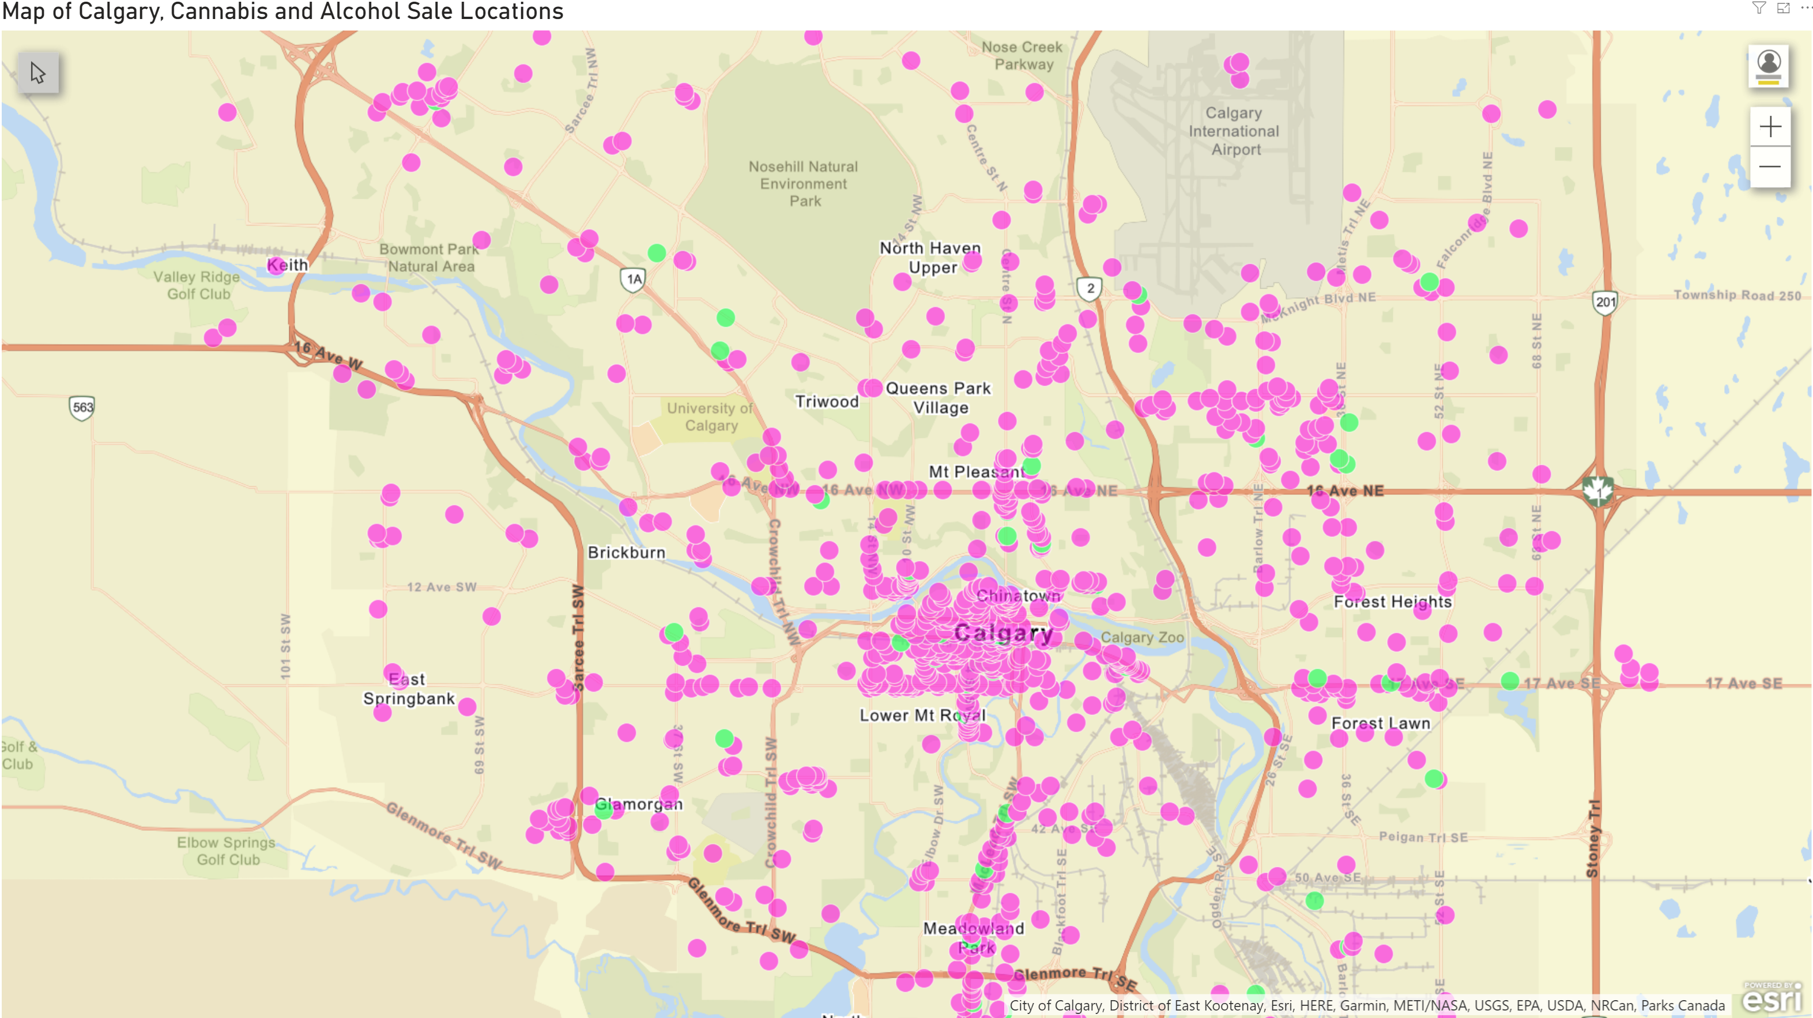
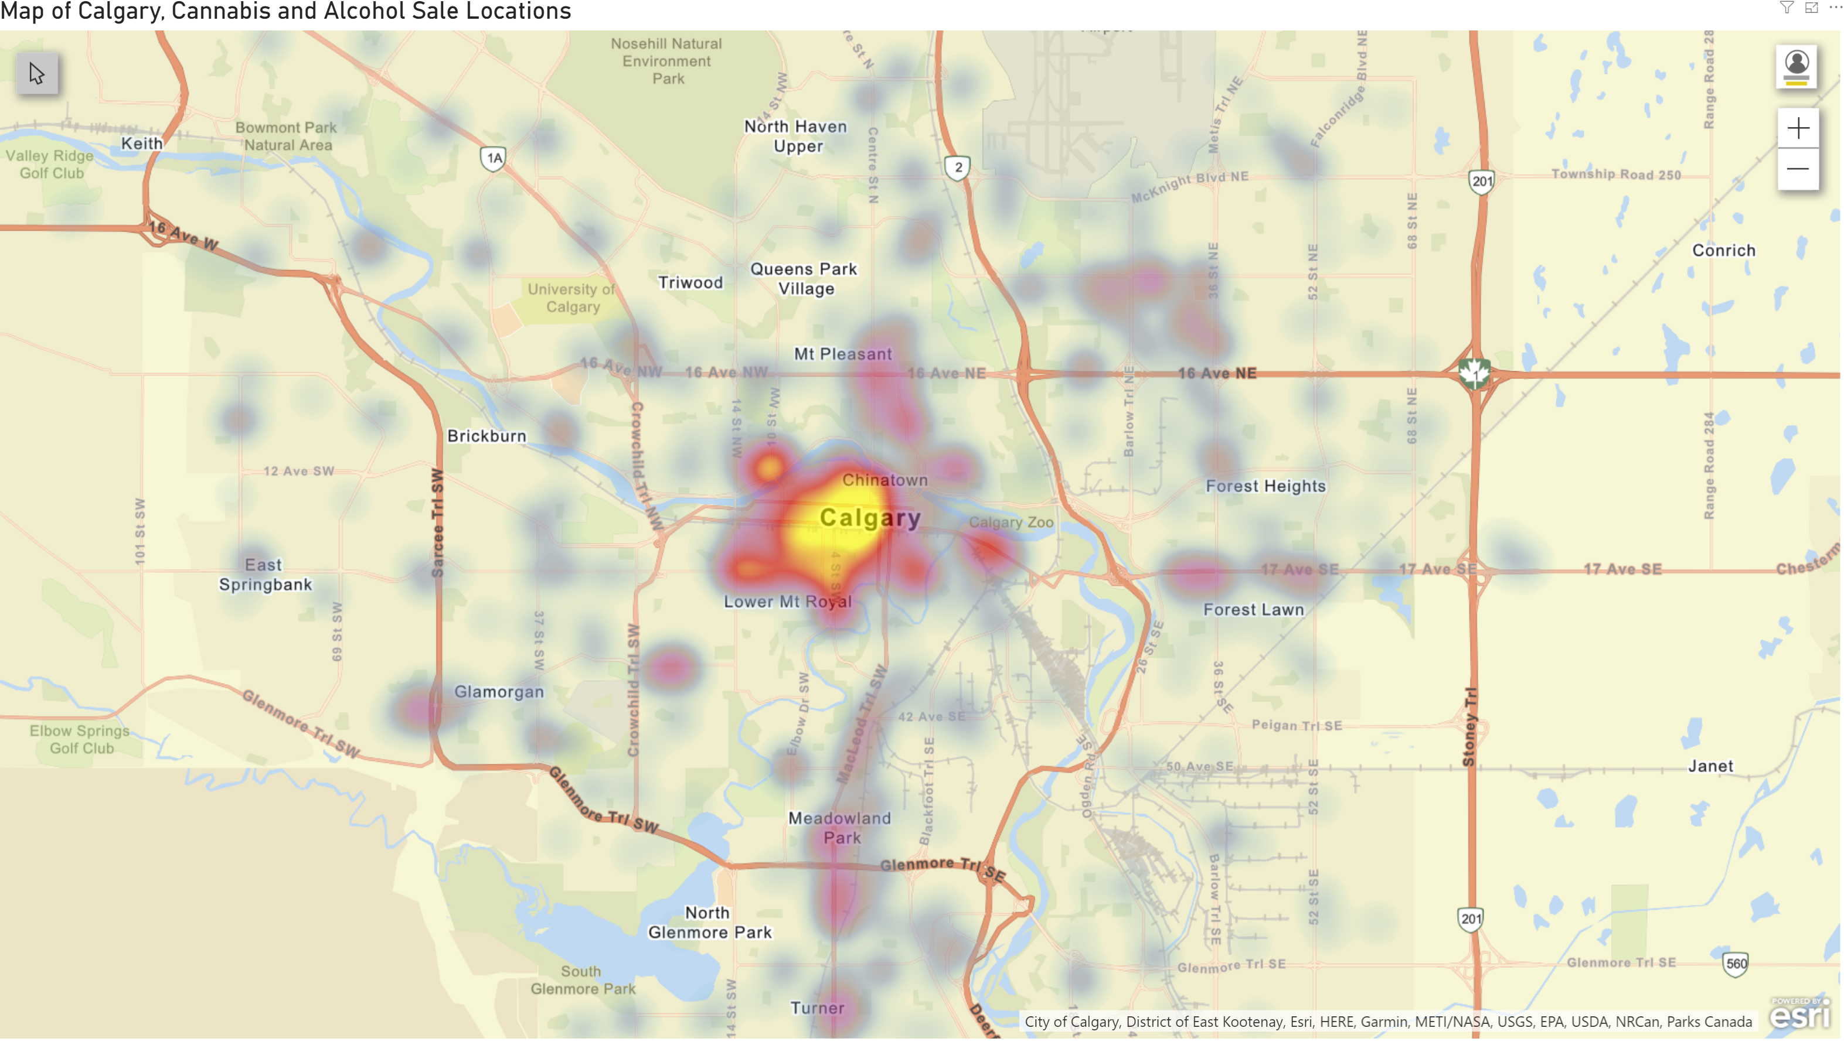
POWER BI VISUALIZATIONS
Legend:
Purple – Alcohol sales
Green – Cannabis sales
Initial views show us that Southern Calgary has the most alcohol and cannabis stores. First impression is that they party the most.
Notes:
- Mention downtown Calgary!

Slide 6
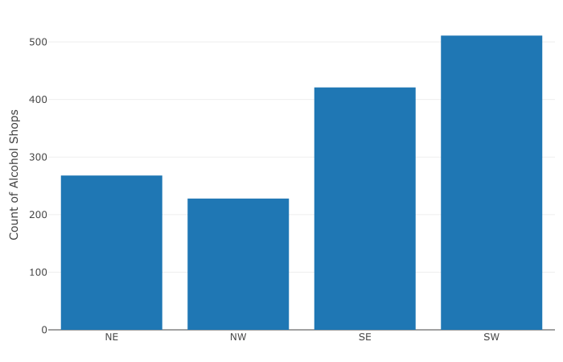
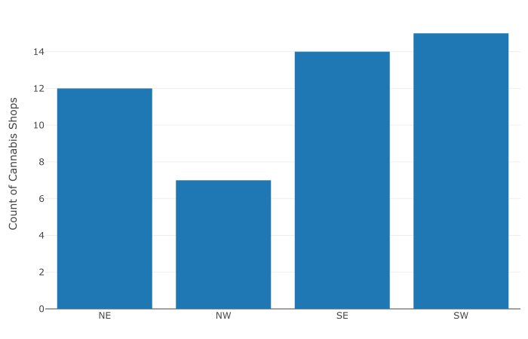
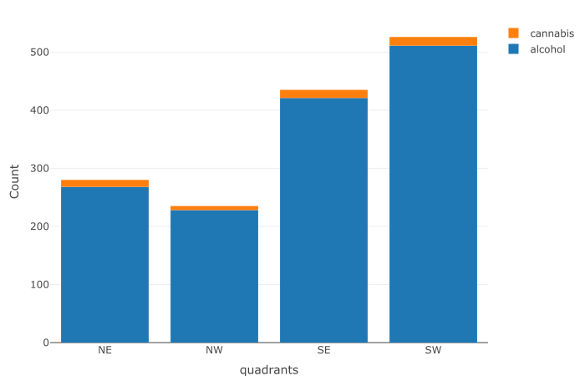
BAR CHARTS (Using plotly)
Same findings as before, it looks like the Southern quadrants of Calgary dominate when it comes to partying (business license of Alcohol and Cannabis).
Interesting is how low the NW is to the four other quadrants, wonder if that has to do with Higher Income neighborhoods, or more family-oriented living in the North West.
For the hypothesis testing, we will be using the total data, cannabis and alcohol included, as both tend to follow the same trends in location.

Slide 7

HYPOTHESIS TESTING (Proportions test)

Slide 8
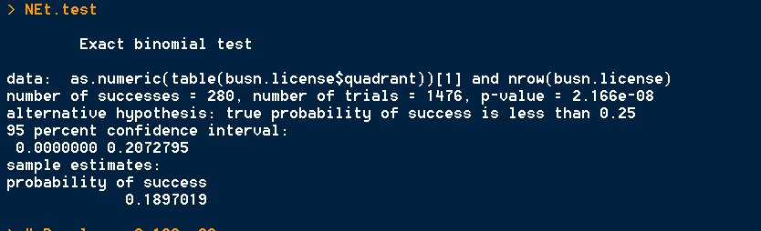
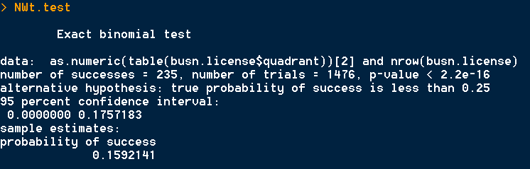
Northern proportions test (Less than)
With these hypothesis tests in the Northern quadrants of the city, we can see that we would reject the null hypothesis of both tests.
This leads us to believe that the people of the Northern quadrants party less,
(or that there is a lower number of places to purchase alcohol and cannabis in the North compared to the city average)

Slide 9
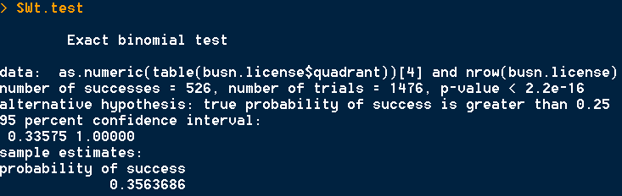
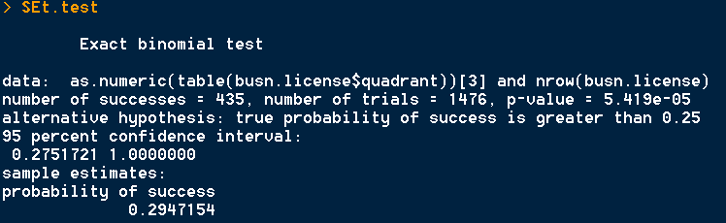
SOUTHERN proportions test (GREATER than)
In the Southern quadrants I went with greater than proportion tests due to what we saw in the visuals.
Both the tests reject the null hypothesis, meaning that the Southern quadrants are truly the party areas of Calgary,
(or, more accurately, there is higher number of locations to purchase alcohol and cannabis in the Southern quadrant compared to the city average)

Slide 10
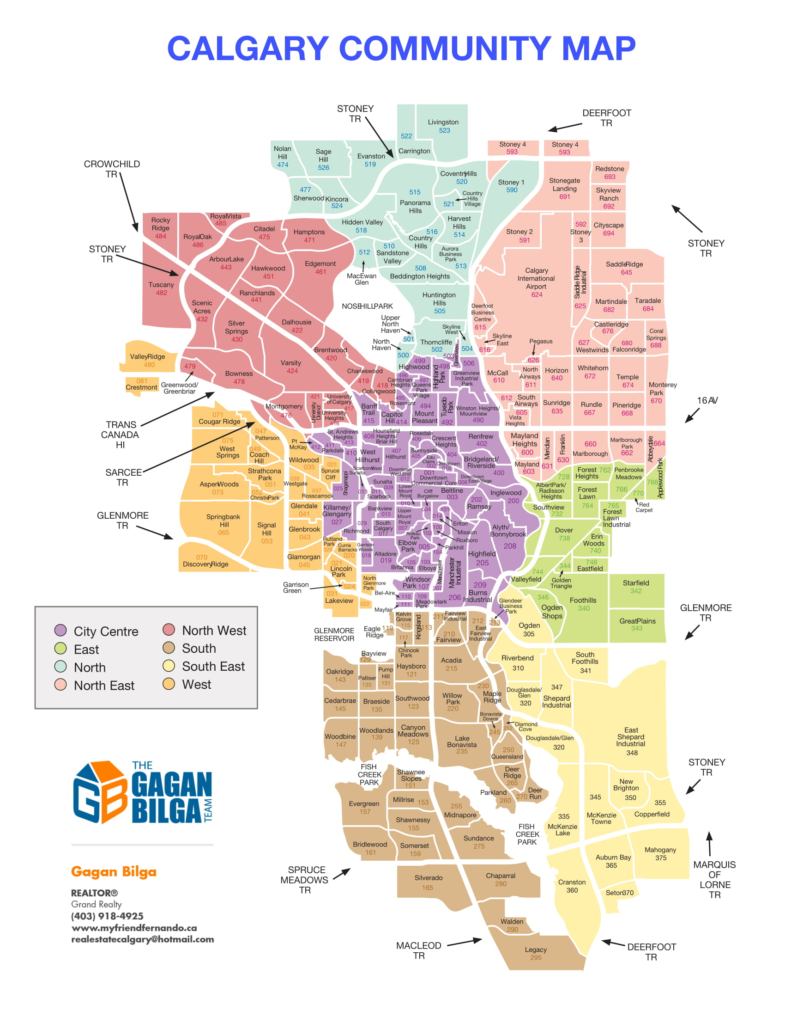
Results (summary)
In the end, it appears that the highest density or best place to go to party in Calgary will be the Southwest.
We found this throughout our visualizations and our proportion tests.
Moving forward, I wonder if I should divide the city into more quadrants as shown in the next picture.
I wonder, like I said previously about the NW, if higher income areas or family-oriented neighborhood affects the amount of locations where you can purchase alcohol and cannabis.
In the end, my conclusion seems to lead to more questions!

Slide 11
Thank you

